Slide 1

Under-Sampling in Digital Images
ITA-0506 COMPUTER VISION SLOT D
Supervised by:
Presented by:
Dr Jeni Gracia
Chaitra (192425217)

Slide 2


UNDER-SAMPLING IN DIGITAL IMAGES
What is Under-Sampling?
Under-sampling occurs when an image is sampled at a rate lower than required to capture all its details. As a result, some visual information is lost, causing distortion and reduced image quality.
Key Points
Sampling converts a continuous image into pixels.
Low sampling rate results in fewer pixels.
Fine details cannot be represented accurately.
Often leads to aliasing (jagged edges and false patterns).
Diagram:
Original Image
↓
Sampling
↓
Too Few Pixels
↓
Under-Sampled Image

Slide 3
Effects of Under-Sampling
Common Effects
Loss of image details
Blurred appearance
Jagged edges (Aliasing)
Moiré patterns
Reduced image quality
Incorrect object recognition
Example
High Resolution → Sharp Image
↓
Low Resolution → Blurry & Pixelated Image

Slide 4
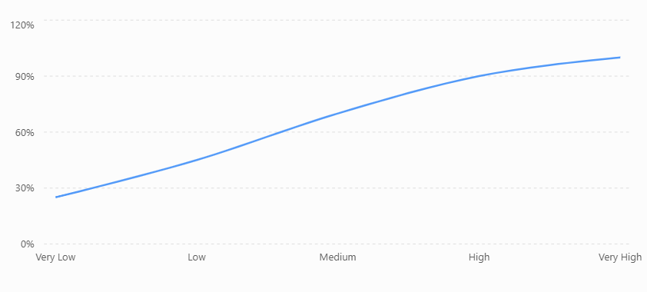
Demonstration Using Graph
Sampling Rate vs Image Quality
Effect of Sampling Rate on Image Quality
Illustrative relationship between sampling rate and perceived image quality.
Observation
As the sampling rate increases, image quality also improves.
Very low sampling rates produce significant distortion and loss of detail.

Slide 5
Real-World Applications
Where Under-Sampling Matters
Medical Imaging (MRI & CT scans)
Satellite Image Processing
CCTV Surveillance
Face Recognition Systems
Autonomous Vehicles
Industrial Quality Inspection
Example Problem
A CCTV camera records video at low resolution. Due to under-sampling, facial features become blurred, making it difficult to identify individuals accurately.

Slide 6
Conclusion
Under-sampling occurs when an image is captured with too few samples (pixels).
It causes aliasing, blurred images, and loss of important details.
Increasing the sampling rate improves image quality and system accuracy.
Proper sampling is essential in healthcare, surveillance, robotics, and autonomous systems.

Slide 7
THANK YOU!

